Slide 1
MATSYAFED INVENTORY MANAGEMENT
Submitted by
Manju Thampi
S6 MCA
Roll:39
SNGCE,Kadayiruppu

Slide 2
INTRODUCTION Matsyafed, the Kerala State Co-operative Federation for Fisheries Development Ltd is an Apex Federation of primary level welfare societies in the coastal fishery sector with the objective of ensuring the economic and social development of the fisher men. Matsyafed has established many commercial units to support the fishermen in procuring fishing inputs and marketing their output, in addition to production and marketing of by-products. In this portion mainly concern the process of OBM division, Head office and the secondary user Vendor and OBM Service centres. Matsyafed OBM Division is one of the major commercial units of Matsyafed. The division imports Suzuki and Yamaha Outboards Motors directly from Japan & Thailand and distribute it to the various OBM Service Centre of Kerala.. Matsyafed is the main importer of YAMAHA and SUZUKI brands of Outboard Motors (OBMs) in South India. OBM Division is also request to Head office when they get limited stock notification and Head office buy the product to the Vendor.

Slide 3
SYSTEM DESIGN AND ANALYSIS 2.1 Challenges of the System Matsyafed has an OBM division at Cochin deals with imported outboard Machines and its spare parts. It is very difficult to manage the inventory of spare parts which runs in 8000 to 10000 components Different model use different spares and it a challenge to keep track of the inventory manually. Matsyafed has different commercial units like OBM Division , fish manures, Chitosan product etc, The inventory of these units also to be maintained. 2.2 Proposed system • Inventory management. • Stock transfer management. • Multiple stores and warehouse interconnection.

Slide 4
Scope
In modern times an inventory management system becomes an integral part of
every organization is using it in their production or retail operations to manage inventory levels. Inventory might be one of a company's most valuable assets and systems to manage it provide the foundation to meet user demand. Inventory systems provide a basis for recording sales; purchases and the quantity for each item at the end of the accounting period there by efficiently manage the inventory. The scope of an inventory system can cover many needs, including valuing the inventory, measuring the change in inventory and planning for future inventory levels. The value of the inventory at the end of each period provides a basis for financial reporting. Measuring the change in inventory allows determining the cost of inventory sold during the period. This allows planning for future inventory needs.
Requirements
The System shall be accessible to various stakeholders based on their roles and privileges.
The System shall be able to manage the different types of inventory being handled by Matsyafed.
The System shall be able to manage / monitor the inventory of OBM division and workshop details on a real time basis.

Slide 5
AGILE TECHNOLOGY OVERVIEW 4.1. INTRODUCTION TO SCRUM ”SCRUM is a subset of agile. It is a light weight process framework for agile development, and the, most widely used one. A”process framework” is a particular set of practices that must be followed in order for a process to be consistent with the framework.” 4.2. PRINCIPLES AND METHODOLOGY USED 4.2.1 Scrum Team A scrum team is a collection of individuals working together to deliver the requested and committed product increments. To work effectively it is important for a scrum team that everyone within the team follows a common goal. The scrum team are typically composed of 7 members and have no team leaders to delegate task or The Development Team: decide how a problem is solved. There are 3 roles in a scrum team: 1. The Product Owner: The product owner is a project’s key stakeholder-Usually an internal or external customer or a scope person for the customer. There is only one product owner who conveys the overall mission and vision of the product which the team is building. The product owner is ultimately accountable for managing the product backlog and accepting completed increments of work.

Slide 6
2. The Scrum Master: The scrum master is the servant leader to the product owner, development team and organization. With no hierarchical authority over the team but rather more of a facilitator, the scrum master ensures that the team adheres to scrum theory, practices and rules. The scrum master protects the team by doing anything possible to help the team perform of the highest level. This may include removing impediments, facilitating meetings and helping the product owner groom the backlog. 3. The development team is a self organizing, cross functional group armed with all of the skills to deliver shippable increments at the completion of each sprint. 4.2.2 Scrum Events Scrum events are time-boxed events that means in a project, every scrum events has a predefined maximum duration. These events enable transparency on the project progress to all who are involved in the projects. The vital events of scrum are -the Sprint. 1. The Sprint: A sprint is a time-boxed period during which specific work is completed and made ready for review. Sprint are usually 2-4 weeks long but can be as short as 1 week. 2. Sprint Planning: Sprint planning team meetings are time-boxed events that determine which product backlog items will be delivered and have the work will be achieved.

Slide 7
.3.The daily Stand-up: The daily stand-up is a short communication meeting in which each team member quickly and transparently covers progress since the last stand-up ,planed work before the next meeting and any impediments that may be blocking his or her progress. 4. The Sprint Review: The sprint review is the”show and tell” on demonstration events for the team to present the work completed during the sprint. The product owner checks the work against predefined acceptance criteria or either accept or reject the work. The stakeholder or client give feedback to ensure that the delivered incremental must the business model. 5.Retrospective: The retrospective or retro is the final team meeting in the sprint to determine what went well, what didn’t go well and how the team can improve the next sprint. Attended by the team and the scrum master, the retrospective is an important opportunity for the team to focus on its overall performance and identify strategies for continuous improvement on its process.

Slide 8
4.2.3 Scrum Artifacts Scrum artifacts are designed to increase transparency of information related to the delivery of the project, and provide opportunities for inspection and adaptation. They are management products useful for the creation of the specialist product of the project. There are 3 artificats in scrum Product Backlog An extended list of everything that might be needed in the final product. 2. Sprint Backlog Selected items for the product backlog to be delivered through a sprint, along with the task for delivering the item and realizing the sprint goal. 3. The Sprint Review Increment set of all the product backlog items so far in the project. 4.2.4 Scrum Rules The rules of Agile Scrum should be completely up to the team and governed for what works best for their processes. The best agile will tell teams to start with basic scrum events listed above and then inspect and adopt based on your teams unique needs so there is continuous improvement in the way teams work together.

Slide 9
SPRINT
In product development, a sprint is a set period of time during which specific work has to be completed and made ready for review. Each sprint begins with a planning meeting. During the meeting, the product owner (the person requesting the work) and the development team agree upon exactly what work will be accomplished during the sprint. The development team has the final say when it comes to determining how much work can realistically be accomplished during the sprint, and the product owner has the final say on what criteria need to be met for the work to be approved and accepted. The duration of a sprint is determined by the scrum master, the team’s facilitator. Once the team reaches a consensus for how many days a sprint should last, all future sprints should be the same. Traditionally, a sprint lasts 30 days
Burn-Down Chart
(ideal)

Slide 10
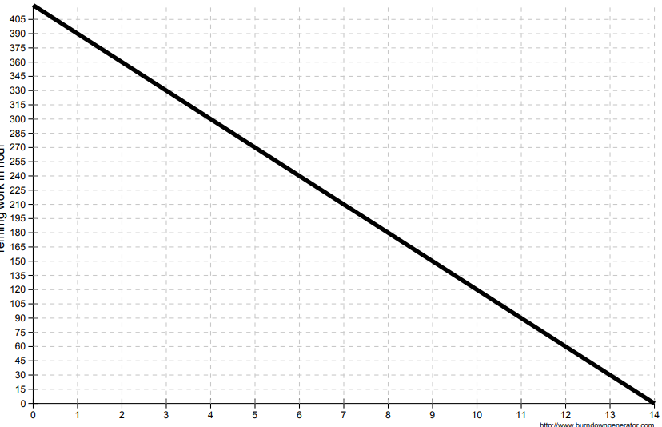

Slide 11
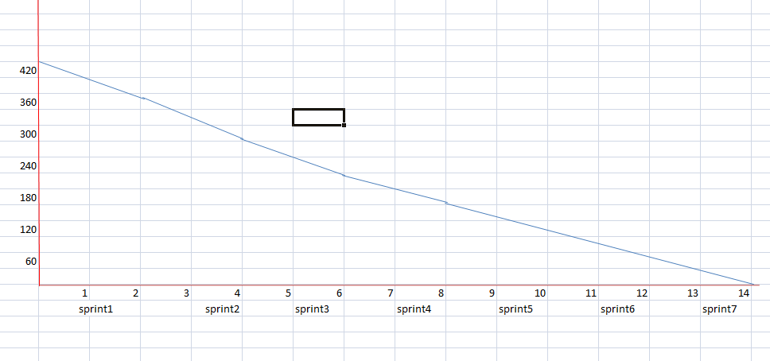

Slide 12
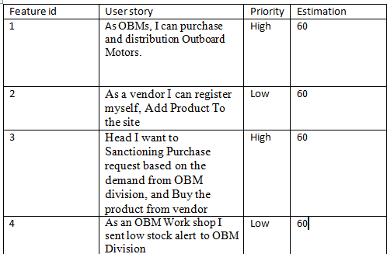
Product Backlog

Slide 13
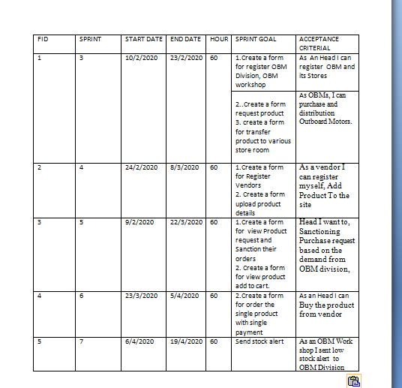
Sprint planner

Slide 14
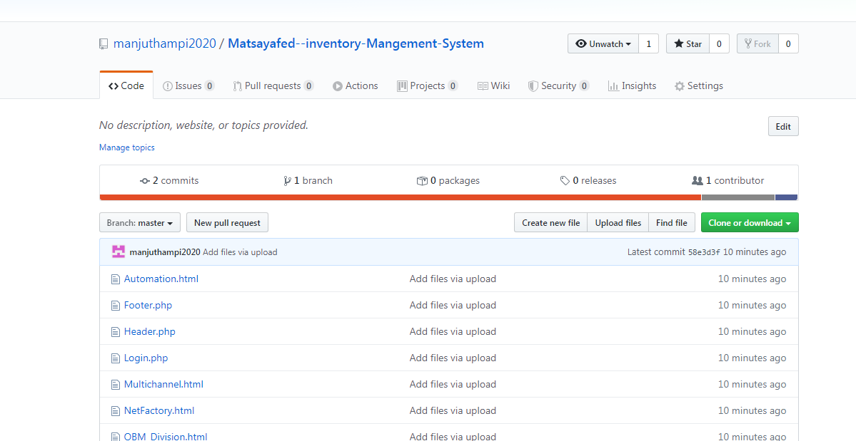
Github Registration

Slide 15
SYSTEM DESIGNS Design is the first step into the development phase for any engineered product or system. Design is a creative process. A good design is the key to effective system. The term “design” is defined as “the process of applying various techniques and principles for the purpose of defining a process or a system in sufficient detail to permit its physical realization”. It may be defined as a process of applying various techniques and principles for the purpose of defining a device, a process or a system in sufficient detail to permit its physical realization. Software design sits at the technical kernel of the software engineering process and is applied regardless of the development paradigm that is used. The system design develops the architectural detail required to build a system or product. As in the case of any systematic approach, this software too has undergone the best possible design phase fine tuning all efficiency, performance and accuracy levels. The design phase is a transition from a user-oriented document to a document to the programmers or database personnel. System design goes through two phases of development: Logical and Physical Design.

Slide 16
Modules and Descriptions Vendor Head Office OBM division OBM Workshop 1.Head Office and Vendor Management. If any product request comes in head office, the head office will purchase the product from the Vendor. Once the vendor will register the site, they can post their product in the Matsyafed site. 2.Stock Management. If the stock level decreases in the OBM Workshop they will send an automatic stock alert to the OBM Division. After the alert get the OBM Division send Request to the head office 3.Payment They are 4 Type of payment done in Matsyafed, But in this portion conduct online payment for a single items.

Slide 17
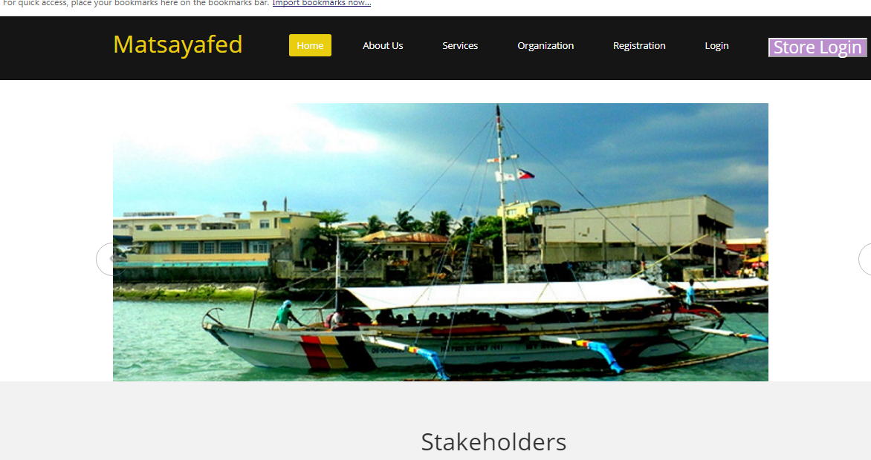

Slide 18

Form design

Slide 19


Slide 20
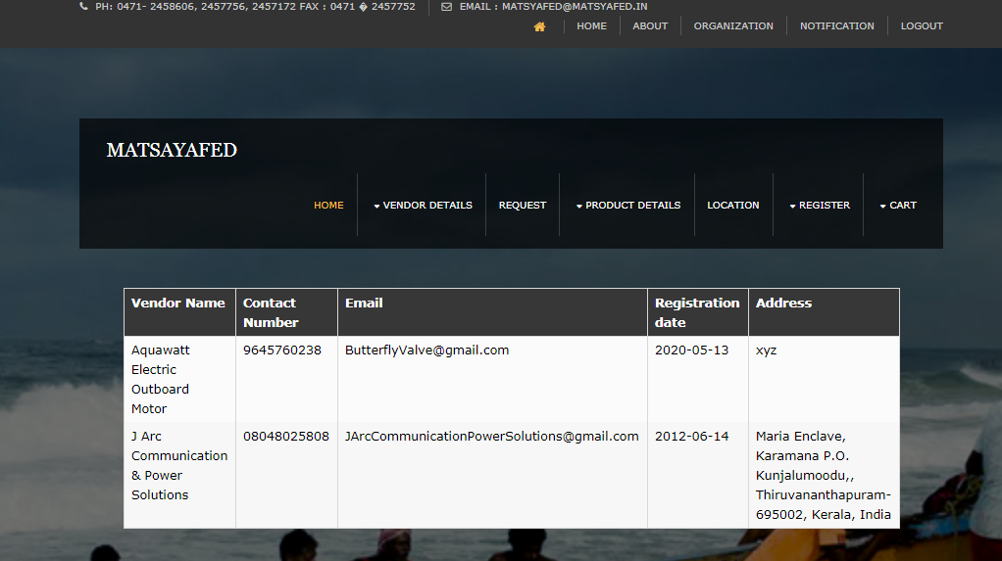

Slide 21
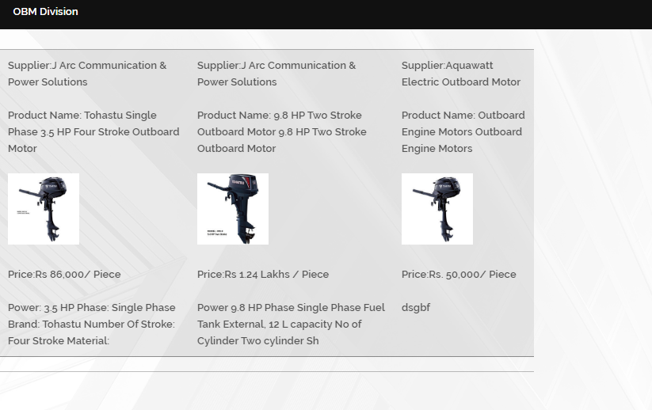

Slide 22
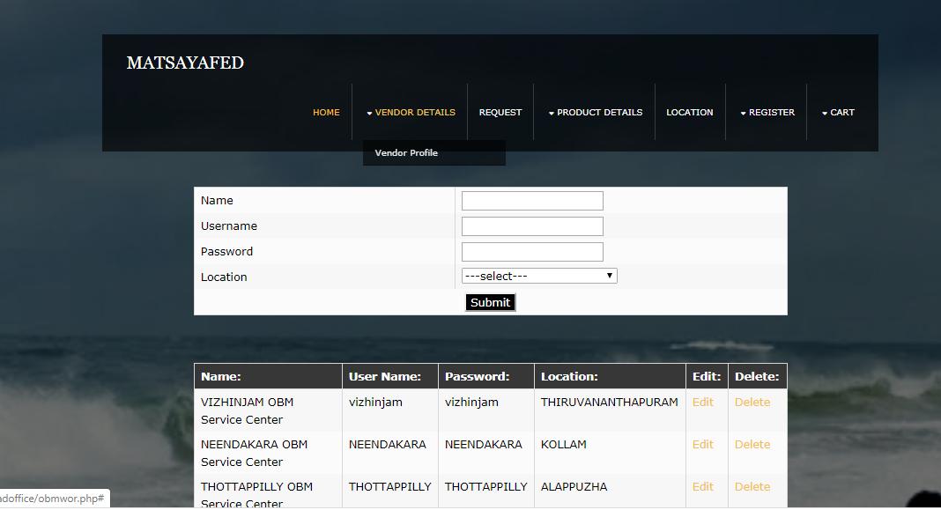

Slide 23
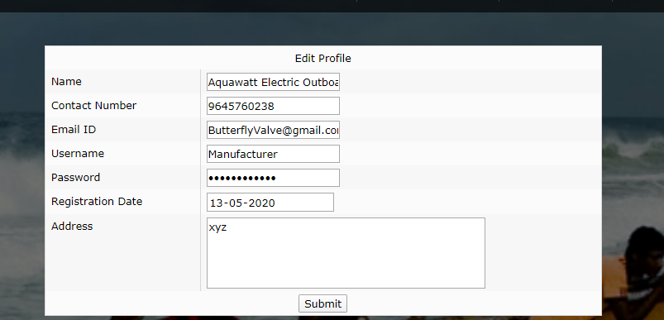

Slide 24


Slide 25
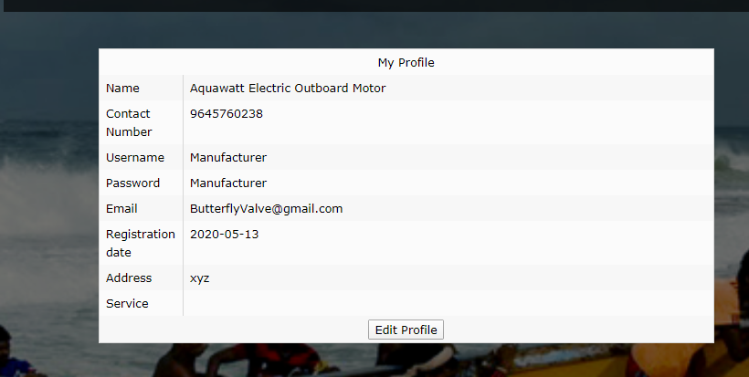

Slide 26
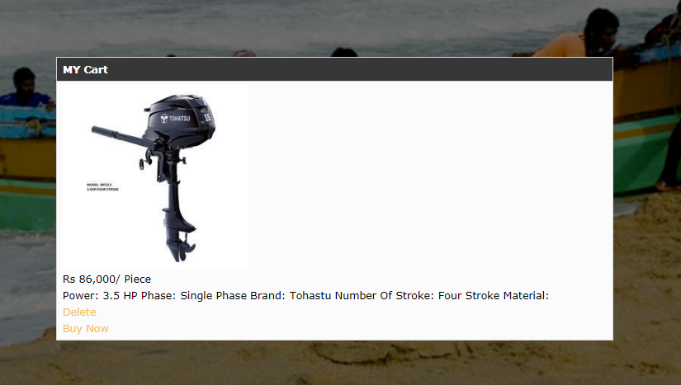

Slide 27
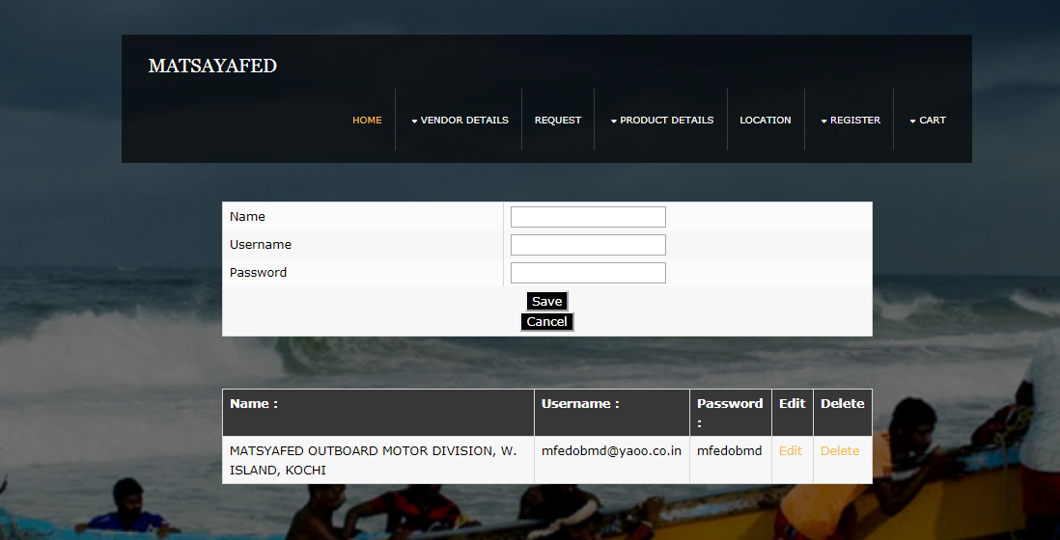

Slide 28
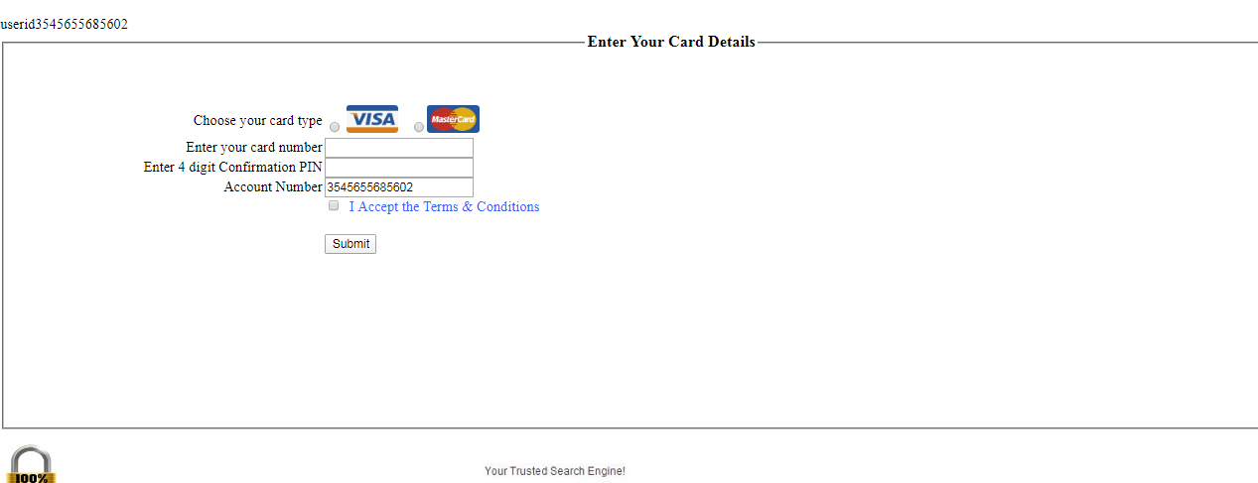

Slide 29
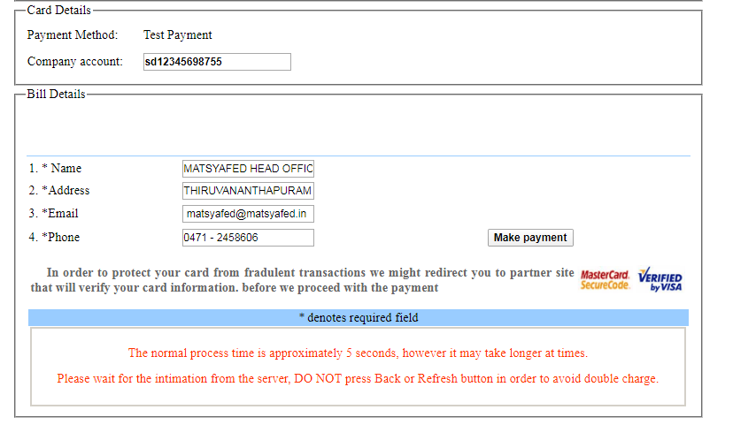

Slide 30
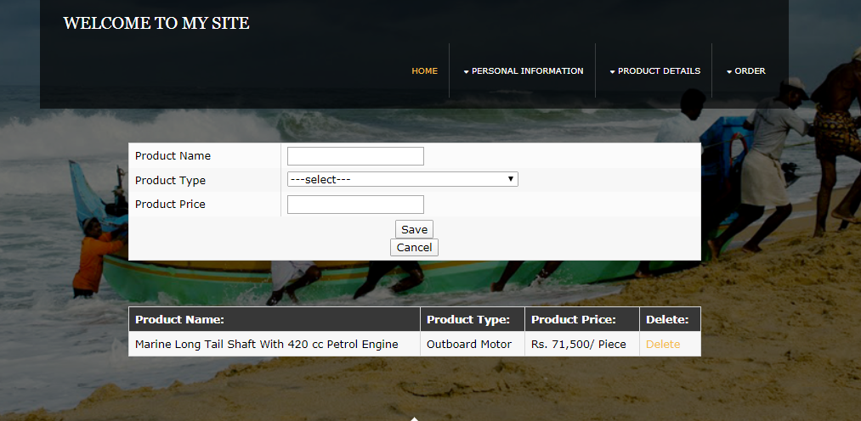

Slide 31
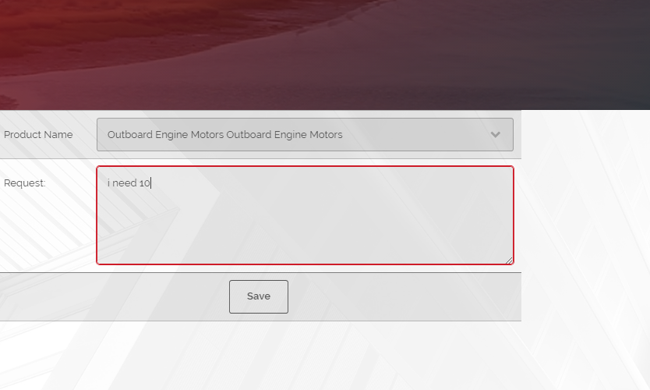

Slide 32
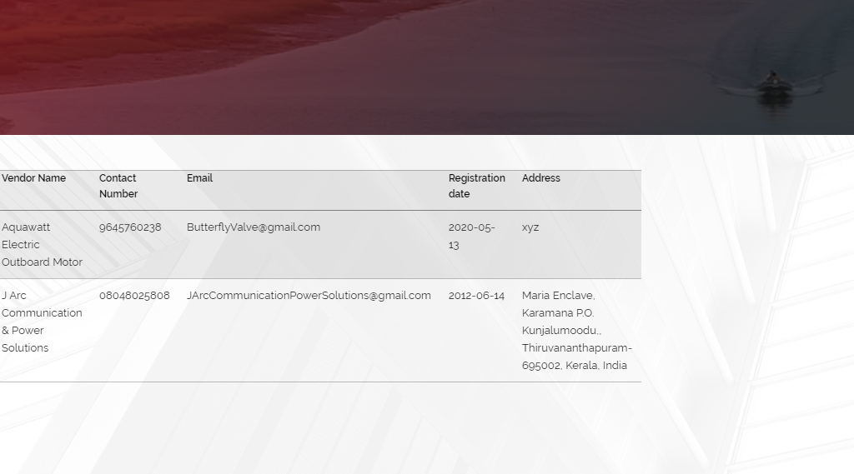

Slide 33
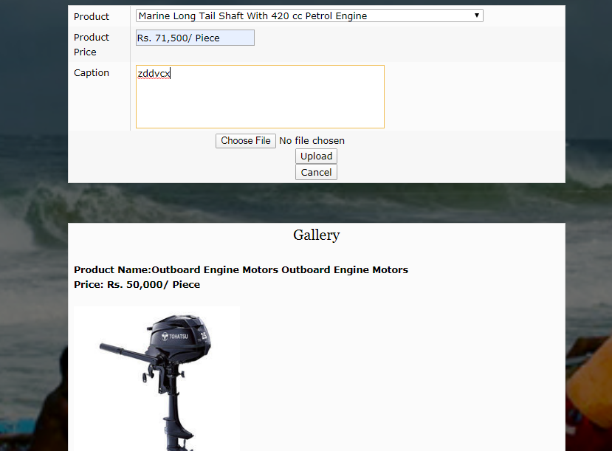

Slide 35
CODE:

